Slide 1


M9: Nature
Project (Part 2)
6th April, 2021

Slide 2








As a wonderful student, I.....
always try my best.
am always kind.
raise my hand before I speak.
listen when someone is speaking.
respect and listen to my teacher.
follow COVID-19 safety rules.

Slide 3




Live Lesson Rules
Be active
and
engaged.
Do not unmute your mic
Be respectful
to your teacher and classmates.
Raise your virtual hand if you would like to speak

Slide 4







Checklist:
Do you have everything you need?
Student's Book
Workbook
  Pen or pencil
  A quiet place.
  Ready to learn!

Slide 5

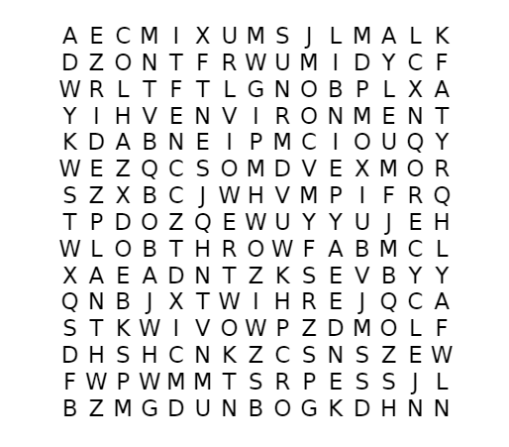

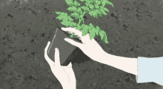


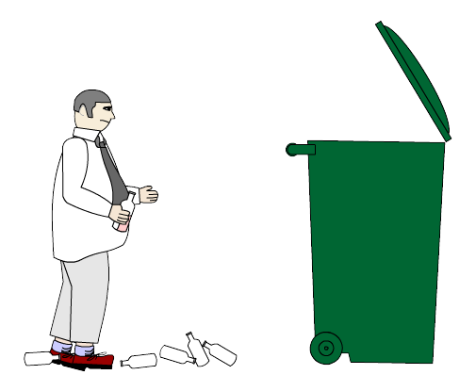
Can you find the 5 words?

Slide 6
Can you find the 5 words?

Slide 7
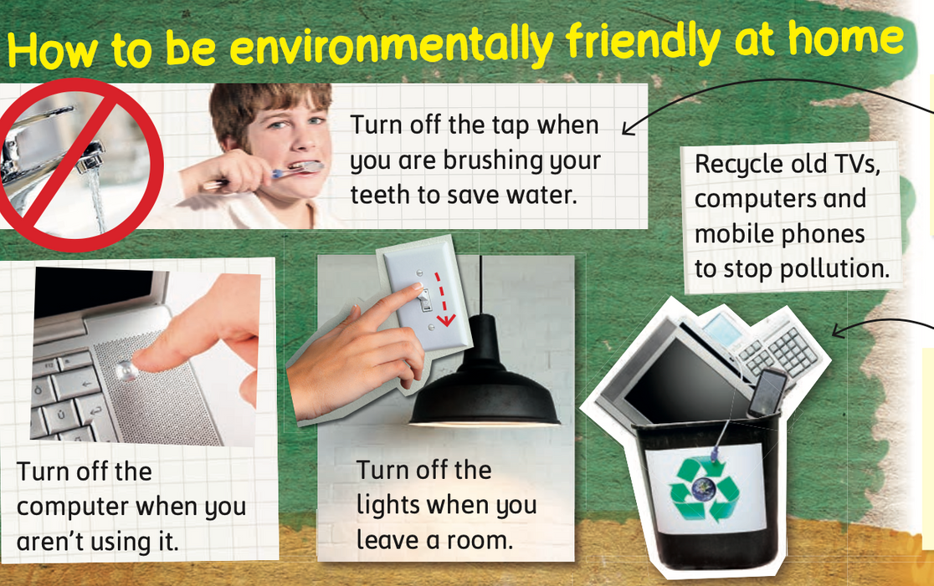


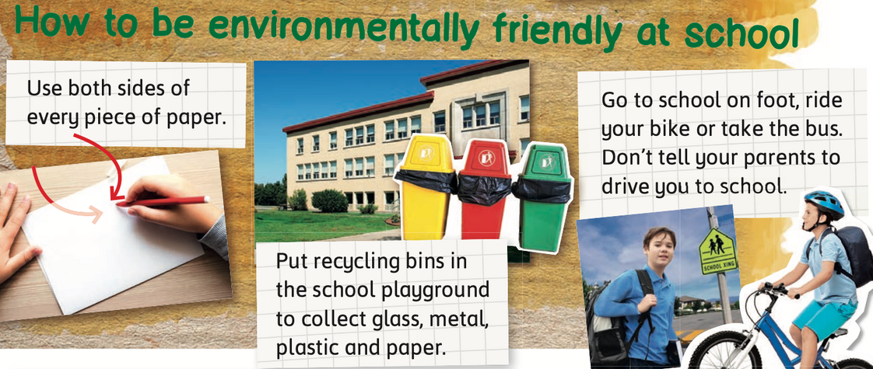
Let’s Recall! Do you remember what we should include in a poster?
Write a title at the top.
Make a list of the things you can do.
NOTE:
We use imperative verbs in our sentences.
Add pictures.

Slide 8
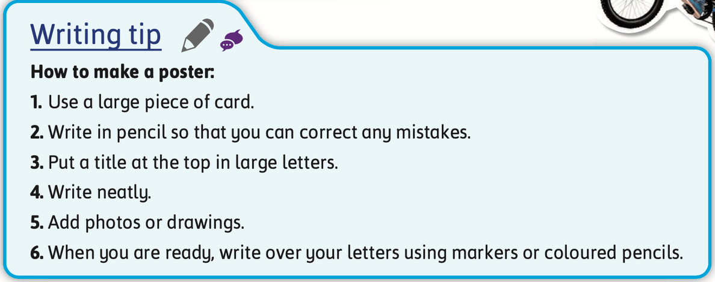
Some TIPS to remember while making our poster!

Slide 9


Today, we will....
Brainstorm to make a poster.
Write a first draft.
Revise and edit the poster.
Share our amazing work with everyone!

Slide 10
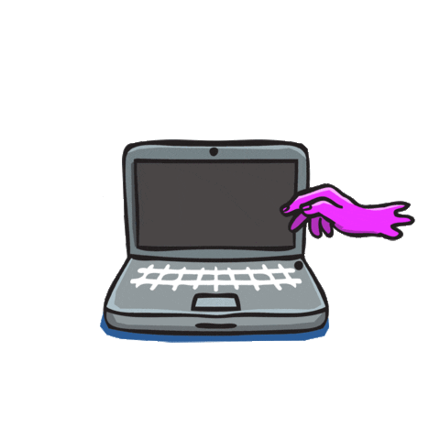
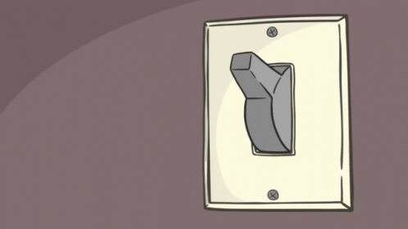
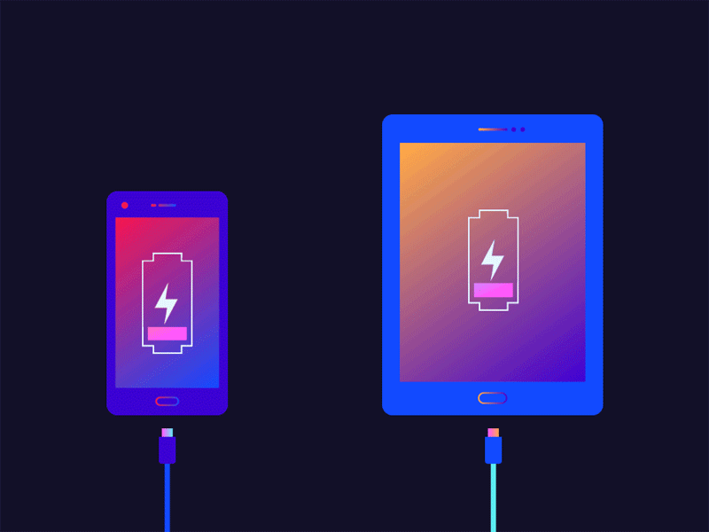
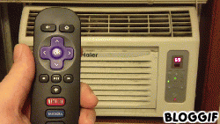

What can we do to be environmentally friendly?

Slide 11
Today, we will....
Brainstorm to make a poster.
Write a first draft.
Revise and edit the poster.
Share our amazing work with everyone!

Slide 12

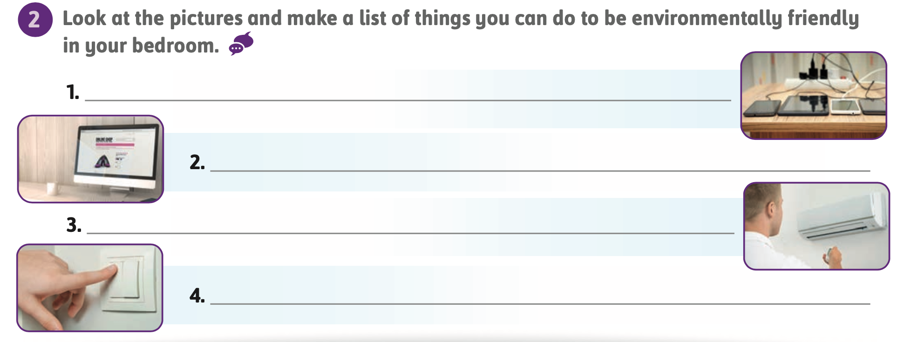
Workbook p.
95
Let's make a list of what you can do!
First Draft
  don’t leave your mobile charging all day.
  Don’t leave the computer on.
  Turn off the AC when you leave the room
  You have to turn off the Light when you leave the Room.

Slide 13
Today, we will....
Brainstorm to make a poster.
Write a first draft.
Revise and edit the poster.
Share our amazing work with everyone!

Slide 14
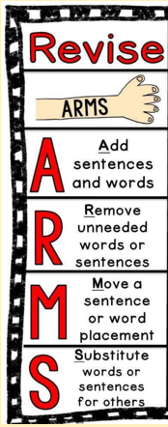

Let’s Revise
Workbook p.
95
  don’t leave your mobile charging all day.
  Don’t leave the computer on.
  when you’re not using it.
  Turn off the AC when you leave the room
  You have to turn off the Light when you leave the Room.

Slide 15

Let’s Edit
Workbook p.
95
  don’t leave your mobile charging all day.
  Don’t leave the computer on when you’re not using it
  Turn of the AC when you live the room.
  Turn off the Light when you leave the Room.

Slide 16
Today, we will....
Brainstorm to make a poster.
Write a first draft.
Revise and edit the poster.
Share our amazing work with everyone!

Slide 17
Let's make a list of what you can do!
Workbook p.
95
Final Draft
  Don’t leave your mobile charging all day.
  Don’t leave the computer on when you’re not using it.
  Turn off the AC when you leave the room.
  Turn off the light when you leave the room.

Slide 18
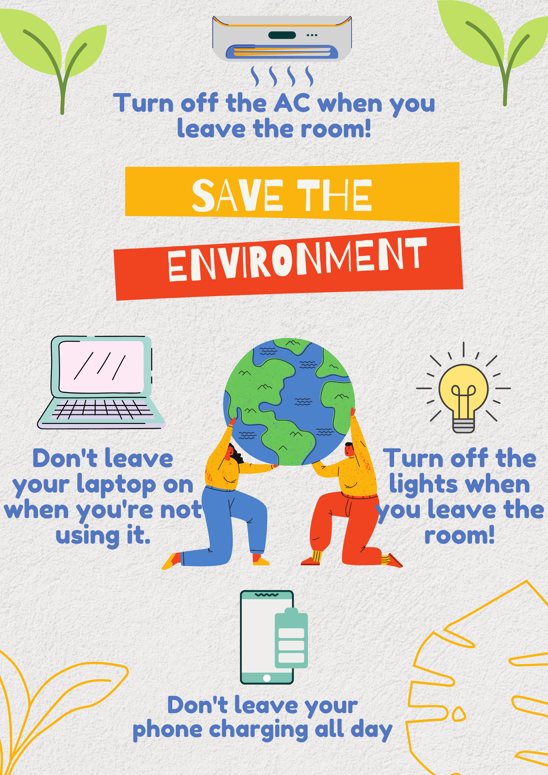
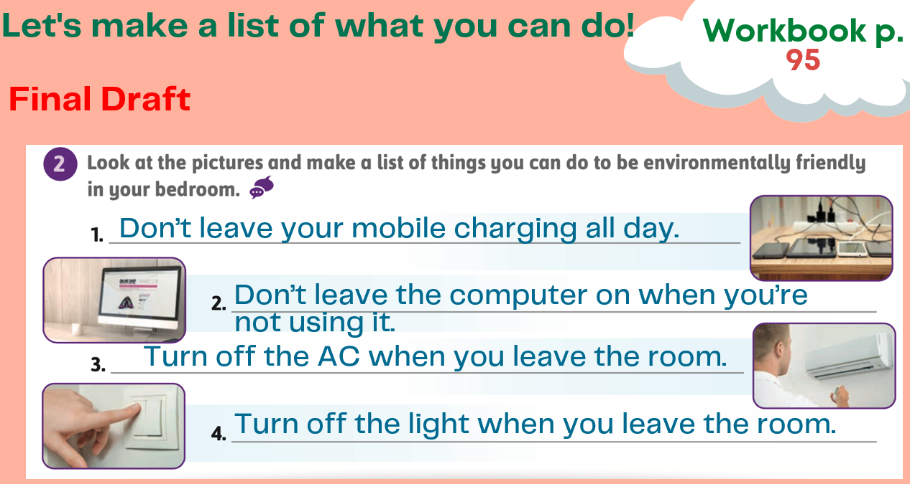

Let’s use our list to make a poster!

Slide 19
Today, we will....
Brainstorm to make a poster.
Write a first draft.
Revise and edit the poster.
Share our amazing work with everyone!

Slide 20


Let’s present our posters!

Slide 21
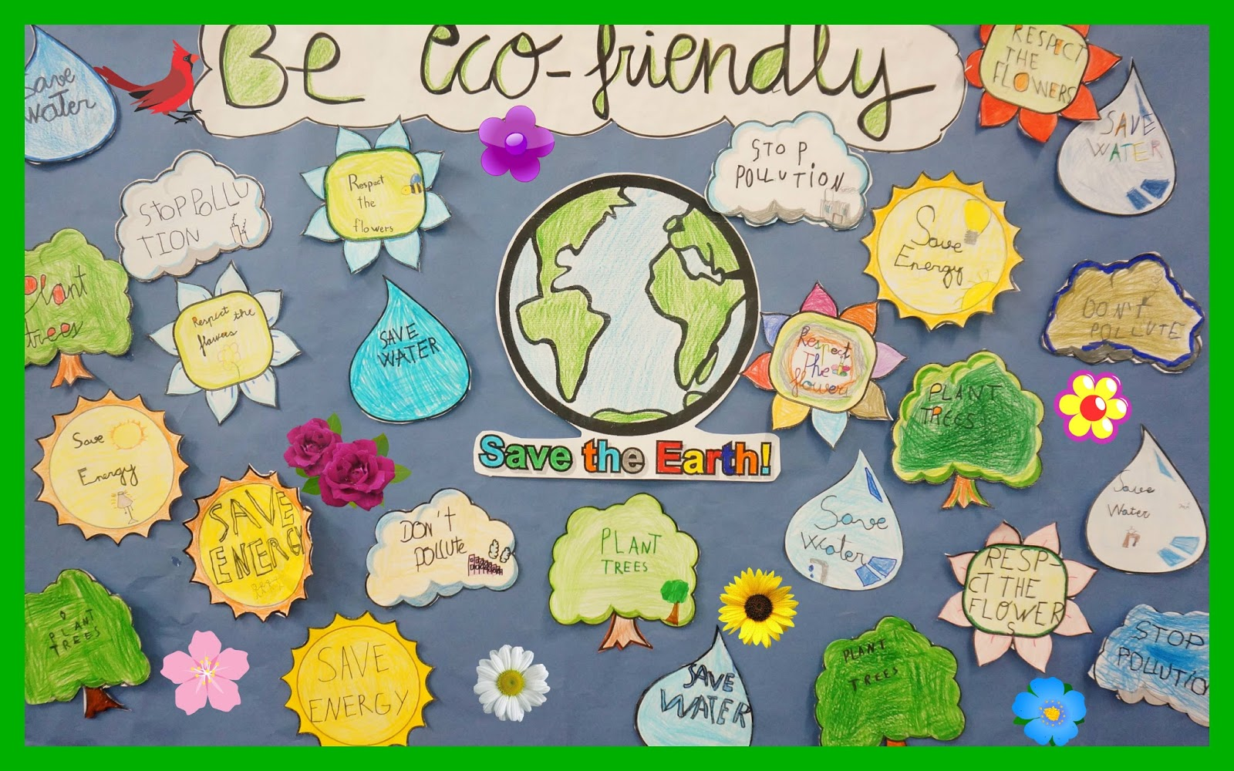


Which of these posters is about being environmentally friendly?
A
B

Slide 22
Thank you for being the BEST!
Have a nice day and stay safe!

